Slide 1


BIOSCOPE:-
“An
Amusement
Hub”.
Bioscope

Slide 2
WHAT IS BIOSCOPE?
The Project “BIOSCOPE” is an App that lets us to know the information related to the movies. This app will be helpful to find the release date of movies, people can search for movies , find out recommendations,also see cast and reviews and trailers of all movies and web series and review any movie and TV shows easily.
In this project, we have used the Recycler view to show the list of the movies. As we click on a movie, it directs the user to another activity that contains the poster along with release date and ratings. On the front page, we have a search interface to search for any movie of our liking. It also contains a spinner that contains options like top rated movies, upcoming movies, now playing and popular movies for the users to choose from.
Bioscope

Slide 3
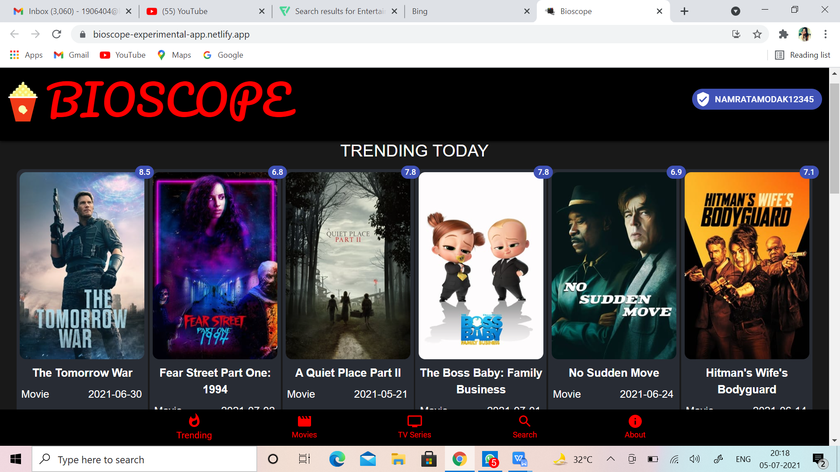
INTRODUCTION:-
Welcome to BIOSCOPE app.We have built an OTT platform with react and Added Firebase Auth to authenticate users .You can search for movies ,
find out recommendations,
also see cast and reviews and trailers of all movies and web series. Below you will find a current list of the available methods on our movie, TV series .
User authentification (email only)
To login/sign in, click on the icon which display
(sign up) from within your home
page page.Here is attatched a snapshot of the App.
Bioscope

Slide 4
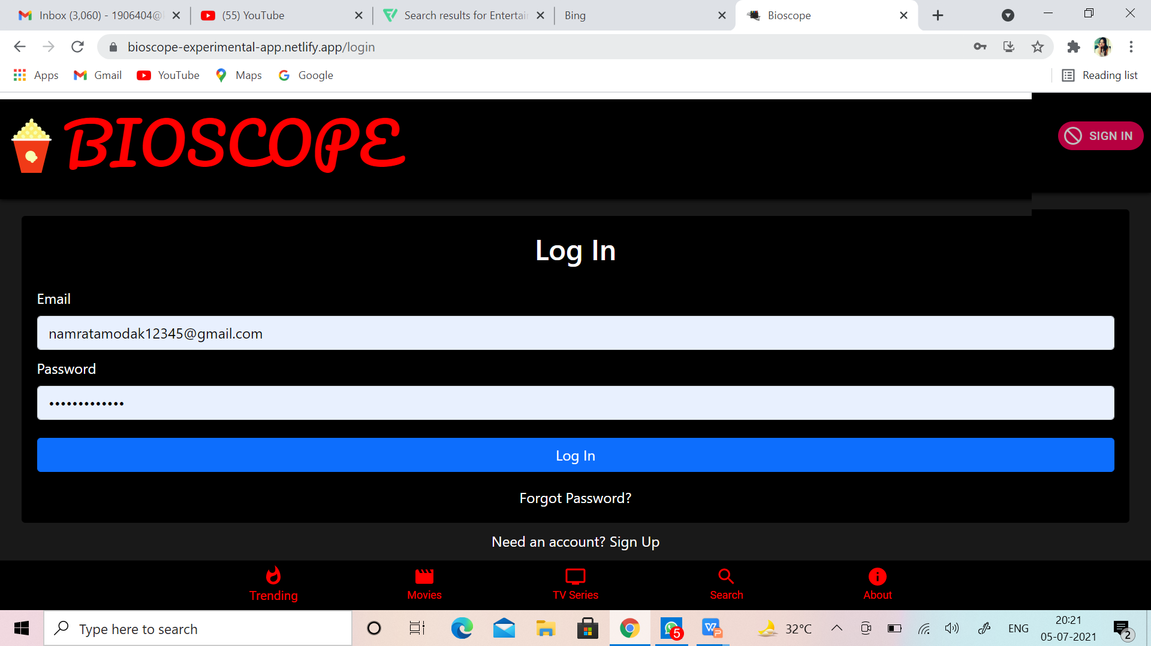
The BIOSCOPE sign in process is optimized for mobile devices also so you can access these pages on a desktop computer , mobile and mobile devices .
A few useful tips...
The configuration methods are useful to get the static lists of data we use throughout
the database. You can find things like the languages, countries, timezones and translations
that we use. The configuration method
also holds useful image
information.
Understanding the basics of our authentication is useful. .
Bioscope

Slide 5

PURPOSE:-
The main purpose of this project to reach out to the people who watch movies very often.
This application aims at providing all information related to the movies at one place to the user.
Bioscope

Slide 6

SCOPE:-
The scope of the application is that it provides the user the information about the movie.
It also gives information about the rating, year of release along with proving them the similar movies to the searched movie.
It gives user to view the currently playing trailer along with the top rated movies, popular movies and upcoming movies.
Bioscope

Slide 7

A SUMMARY OF THE MAJOR FUNCTIONS THE APP WILL PERFORM:-
1. The app contains a search interface in which we can search the movie of our choice along with similar movies.
2. It contains a icon which displays options like trending movies, popular movies, top rated movies etc.
3. The app contains movies displayed in grid layout.
4. On clicking on a movie, the user gets directed to another activity which contains the poster of the movie along with movie description and similar movies.
Bioscope

Slide 8
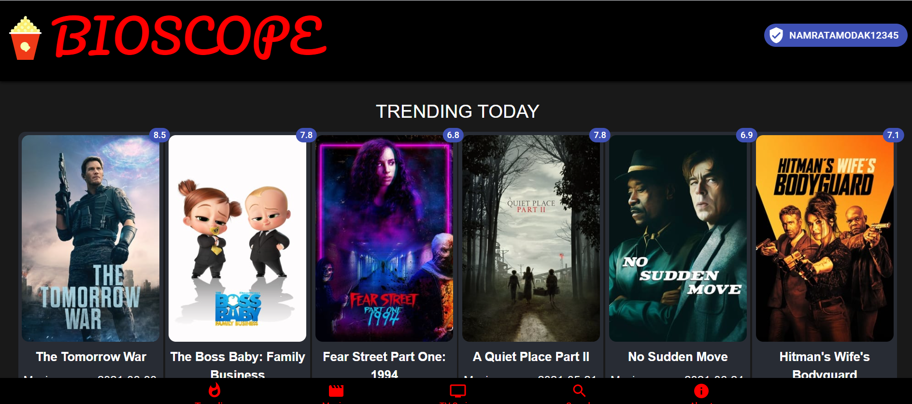
GENERAL FEATURES:-
Top rated Movies
Trending Today
Upcoming Movies
Popular Movies
Popular TV Shows
Top Rated TV Shows
Segregate by genres.
Get recommendations
Make a Favourite list
Bioscope

Slide 9

ACCOUNT FEATURES:-
Get details.
Get lists (created and marked as favourite).
Get favourite movie list.
Get the account state for a movie (rated,
marked as favourite).
Account Session Features.
Rate a movie.
Add/Remove a movie to your favourites.
Add/Remove a movie to your watch list.
Bioscope

Slide 10


MOVIE FEATURES:-
Search:-
Search for movies with a text query and you
can also use voice command to search movies
Discover:-
Search for movies based on data. Movies are
queryable by fields like average rating,
certifications, release dates and genres.
Bioscope

Slide 11

Get Details:-
Primary info
Alternative titles
Cast
Crew
Images (posters, backdrops)
Release information
Trailers
Similiar movies
Reviews
Belongs to lists
Changes
Bioscope

Slide 12
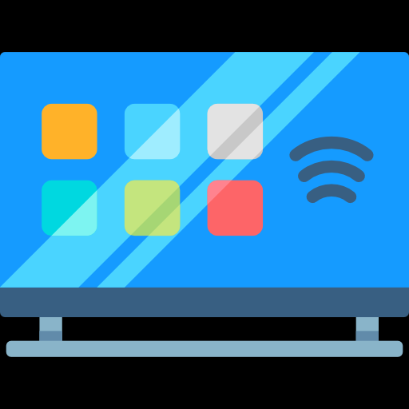
TV FEATURES:-
Search:-
Search for TV series with a
text query and you can also use voice
command to search TV series.
Discover:-
Search for TV series
based on data. TV series are queryable
by fields like average rating, TV network
and genres.
Bioscope

Slide 13

Get Details:-
Primary info.
Cast.
Changes.
Crew.
Images (posters, backdrops)
External IDs.
Bioscope

Slide 14
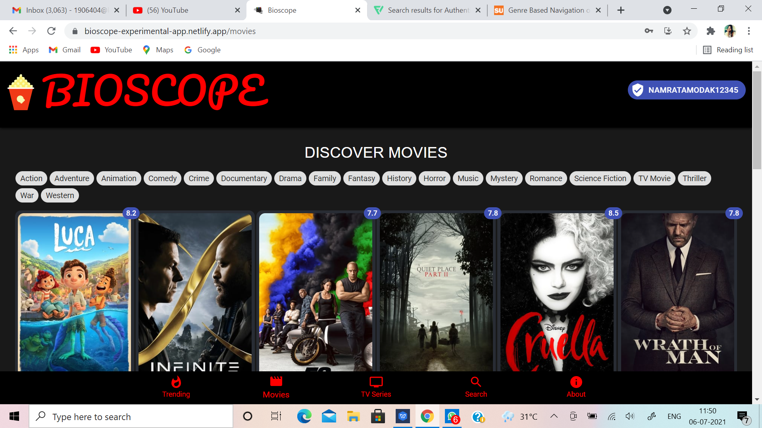
GENRE SEARCH:-
A novel user interface for a web
searching that allows genre-based
navigation through three major
functionalities:-
Limiting search to specified genres
Visualizing the hierarchy of genres
discovered in the search results
Accepting user feedback on the
relevancy of the specified genres.
Bioscope

Slide 15

USER AUTH:-
By logging in, we mean that we need a session Id. This session ID will be further used to get the account details, add a movie to the favourite list , and bring the watchlist and delete a movie from favoritelist .You can also delete the session ID.
There are 2 steps to get the Session ID -
Get a request token by /authentication/token/new. This will give a request token.
Validate the username and password for your account by making authentication/token/validate_with_login with username, password, and request token received in step 1, in the request body to get another request token. If you receive the token, that means the username and password are correct and you can proceed with creating the session. But, if the username and password are invalid, you won’t get the request token and won’t be able to avail the app.
Bioscope

Slide 16
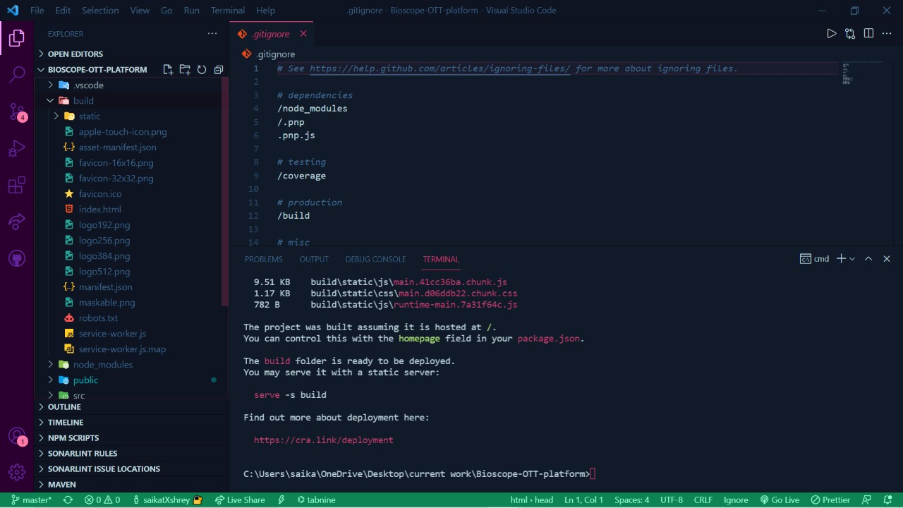
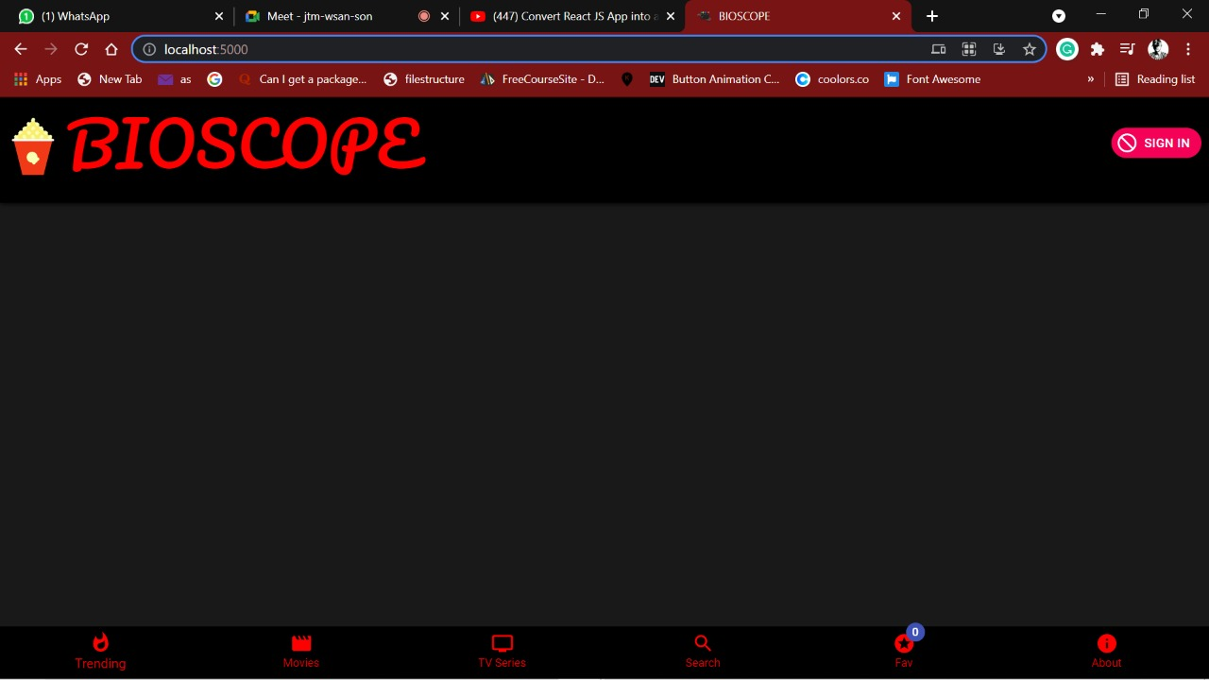
HOSTING & DEPLOYMENT:-
PICTURES OF HOSTING(LOCAL):-
Bioscope

Slide 17
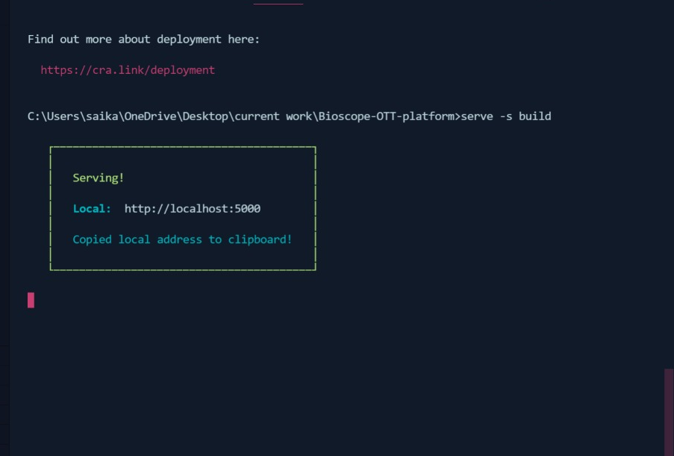
PICTURE OF PRE-DEPLOYMENT:-
Bioscope

Slide 18
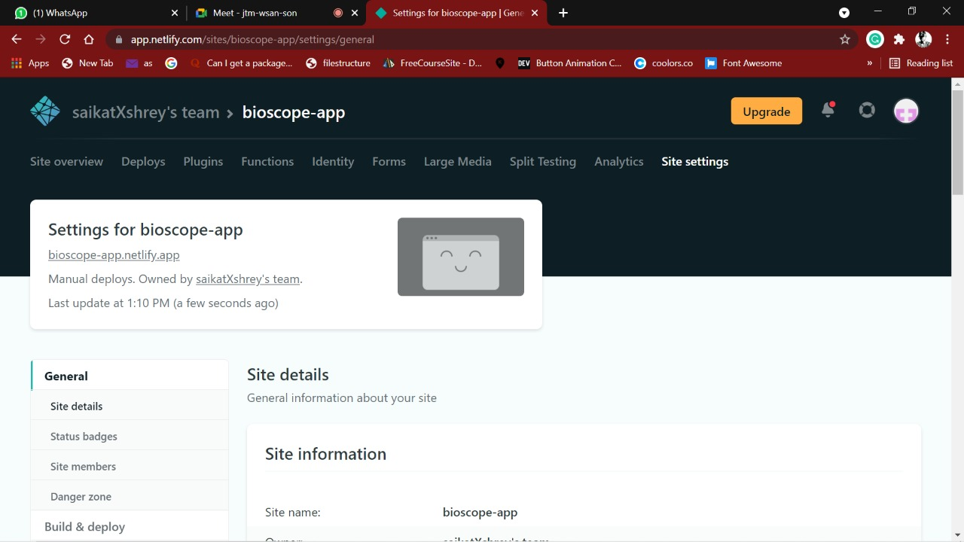
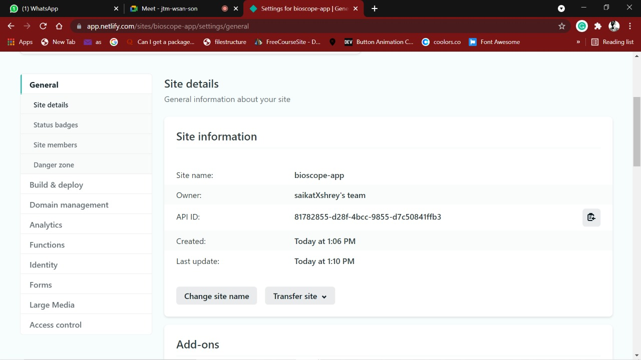
Our website has been hosted in Netlify.com
PICTURE OF HOSTING IN NETLIFY.COM-
-PICTURE OF SITE SETTINGS IN NETLIFY
Bioscope

Slide 19
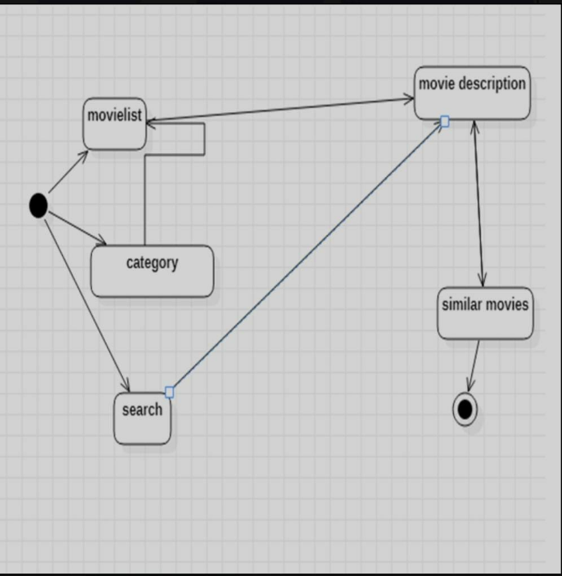
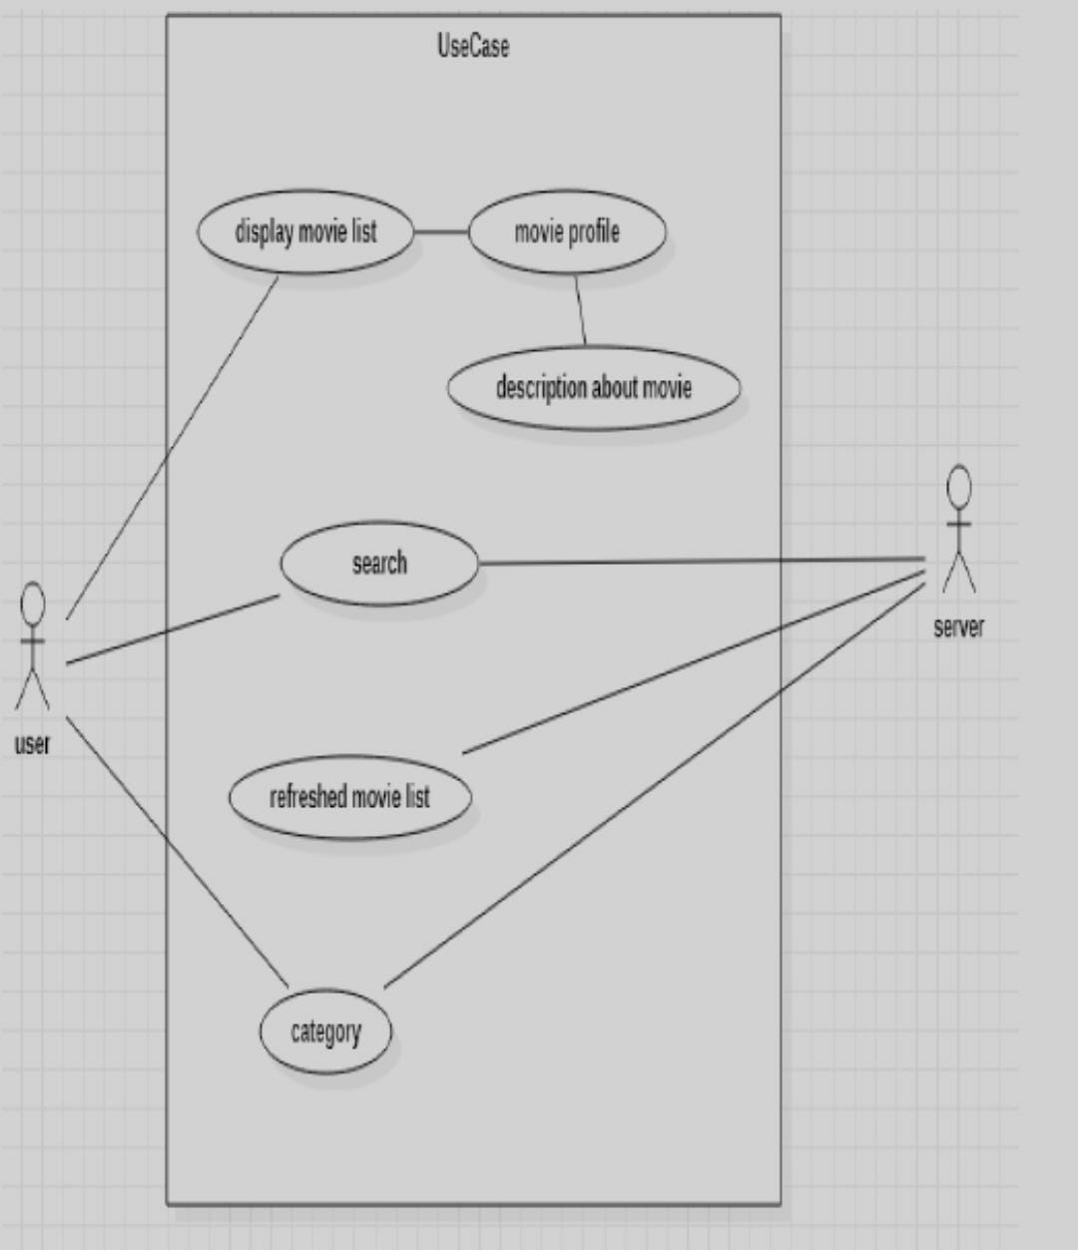
SYSTEM DESIGNS:-
Bioscope

Slide 20

TIME FOR SOME BONUS
Bioscope

Slide 21

1)PWA(Progressive Web App):-
Our App has been converted into Progressive Web Apps-are web apps that use emerging web browser APIs and features along with traditional progressive enhancement strategy to bring a native app-like user experience to cross-platform web applications.In order to call a WebApp a PWA, technically speaking it should have the following features: Secure contexts (HTTPS), one or more Service Workers, and a manifest file.
Bioscope

Slide 22
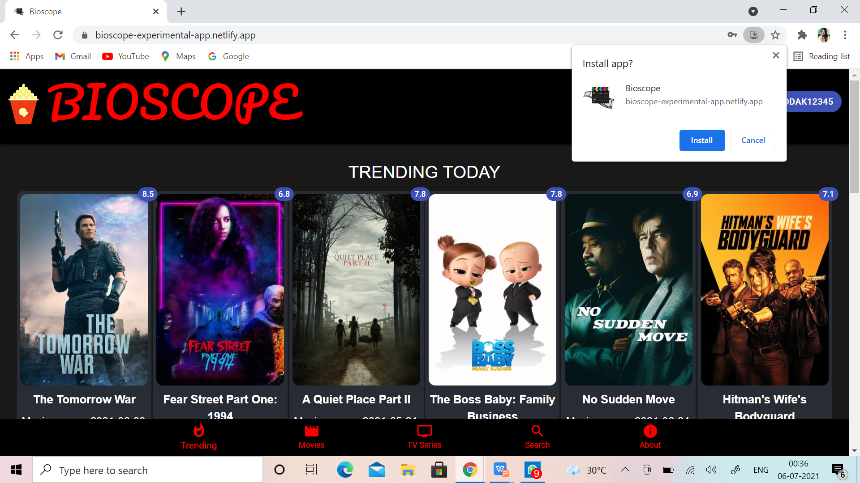
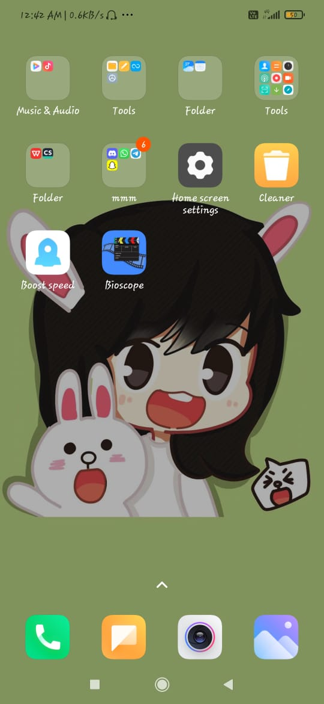
Downloading option in web-page.
APP in Mobile Screen.
Bioscope

Slide 23
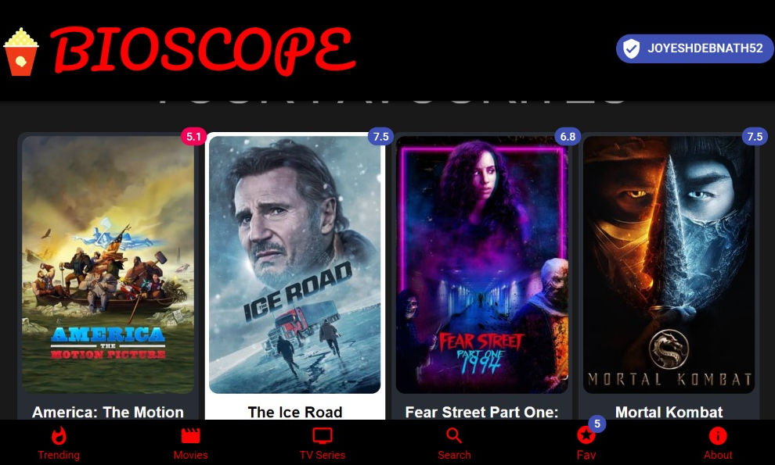
2)FAV-LIST:-
Real time notification in Navbar
to see the number of
favourite movies or
TV shows we have added to
our list.
CRUD Operation is undergoing
in this feature.
Material-UI has been used here.
Bioscope

Slide 24
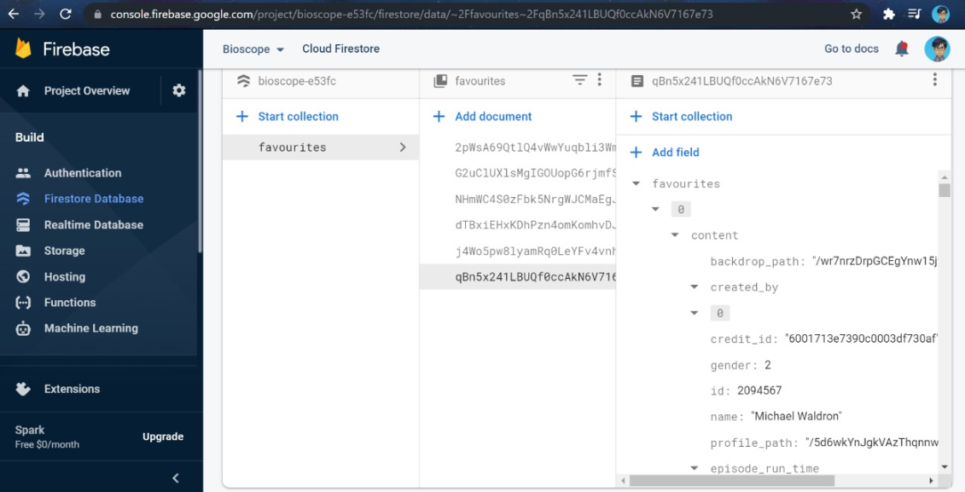
Database of User’s Favourite List.
Bioscope

Slide 25
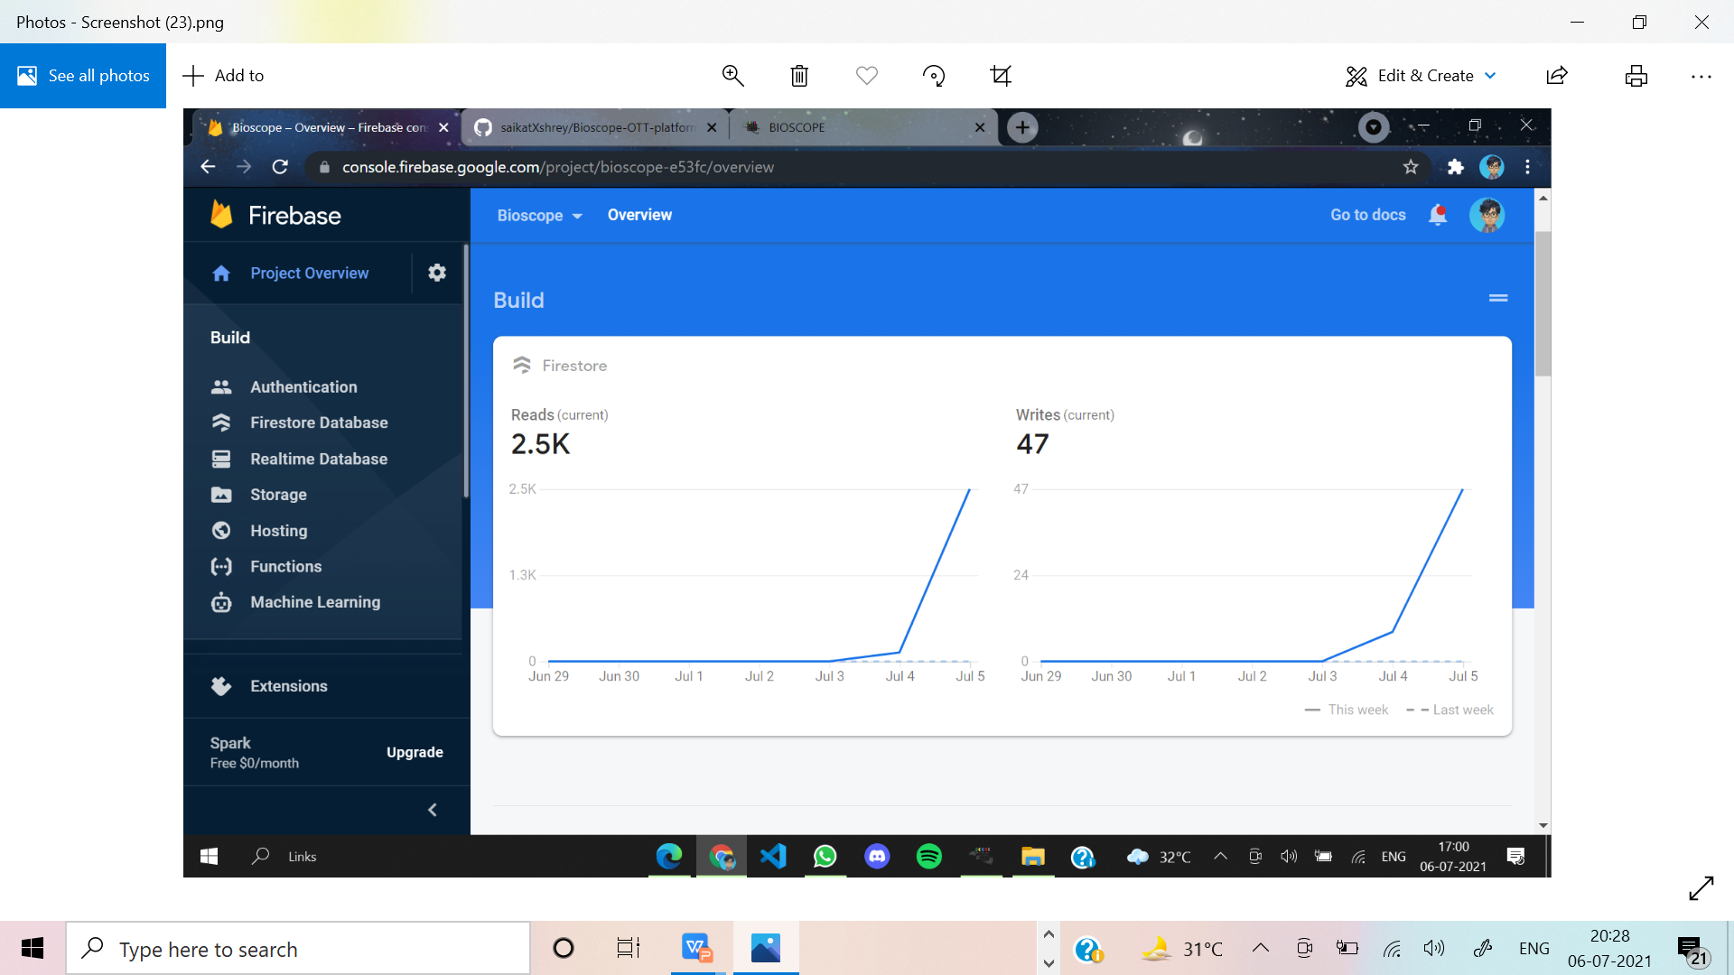
Database Analytics.
Bioscope

Slide 26
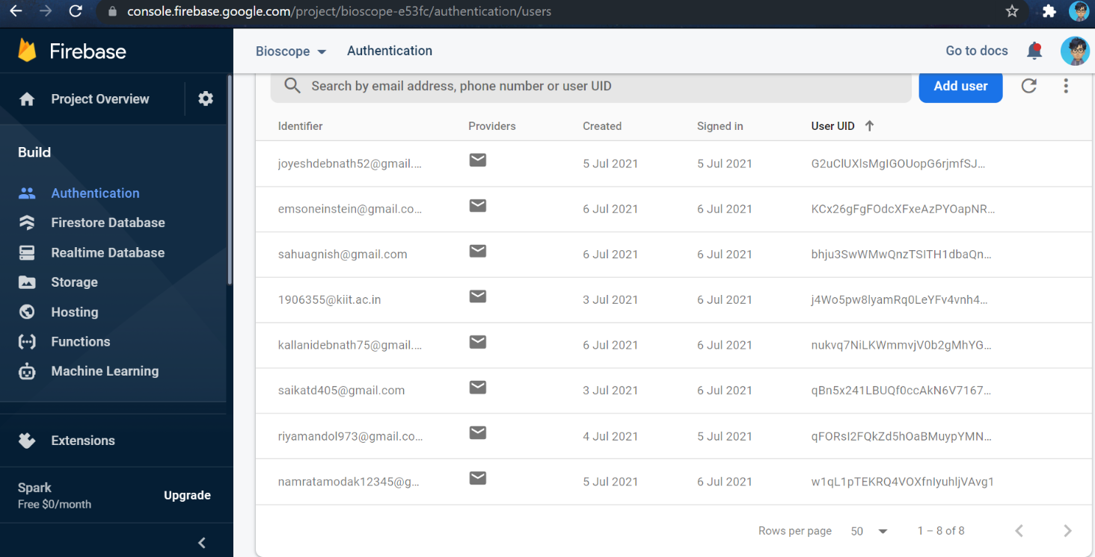
List of Authenticated users in Firebase
Bioscope

Slide 27
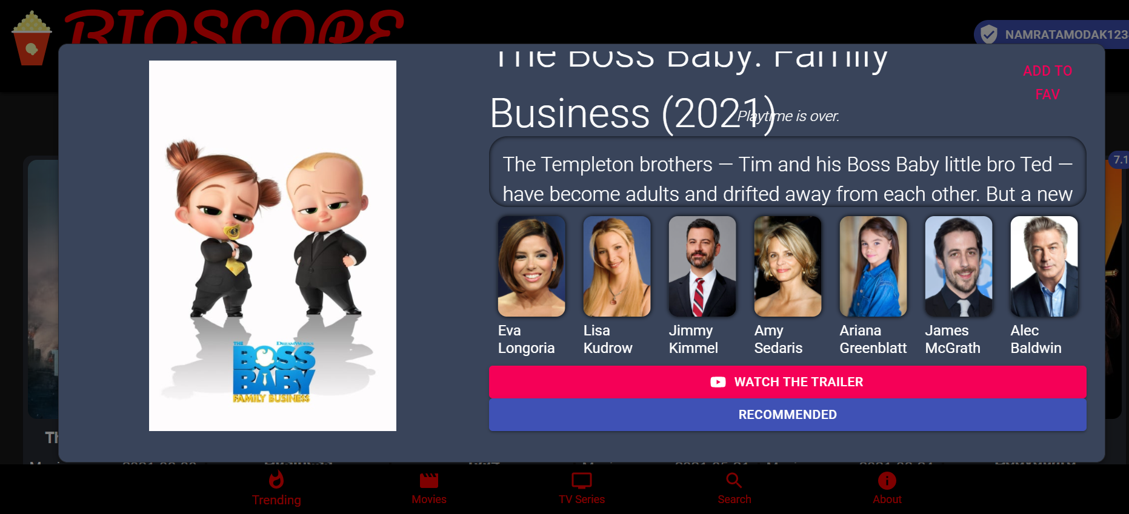
3)RECOMMENDATION-LIST:-
Recommendations of similar movies
will come on the
basis of movies/TV Shows searched.
TMDB database is used in order to
avail this feature.Also we need to
use history and location of react
to pass the information.
Bioscope

Slide 28
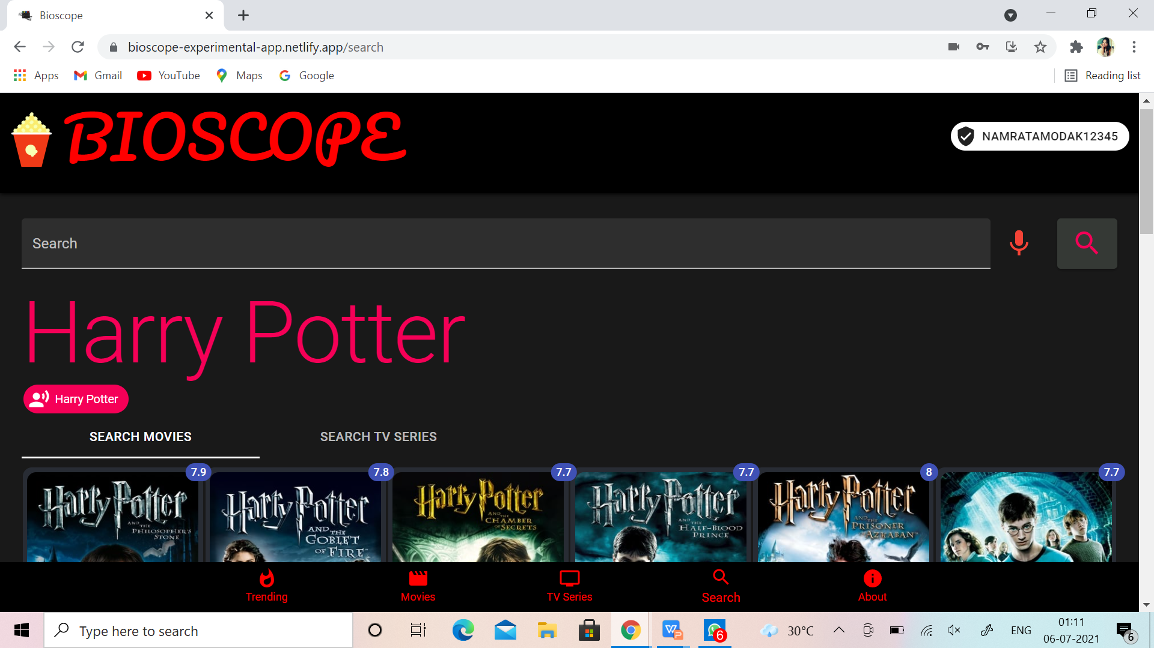
4)VOICE RECOGNITION SEARCH:-
Any movies or TV shows can be also
searched through voice.If one says
“Harry-Potter”,all the related results
will appear in a fraction of seconds.
A NPM Module
(React-voice recognition) is
used here.
Since it is searched through voice.
Bioscope

Slide 29
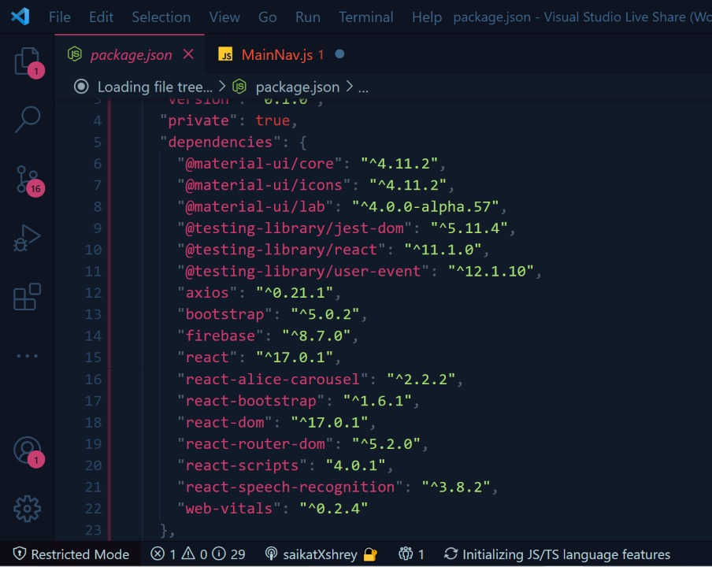
5)OPEN SOURCE npm Packages:-
A module is any file or directory in the
node_module directory that can be
loaded by Node.js require() function.
To be loaded by Node or imported
directly in the React project the
open-source-packages.
Bioscope

Slide 30
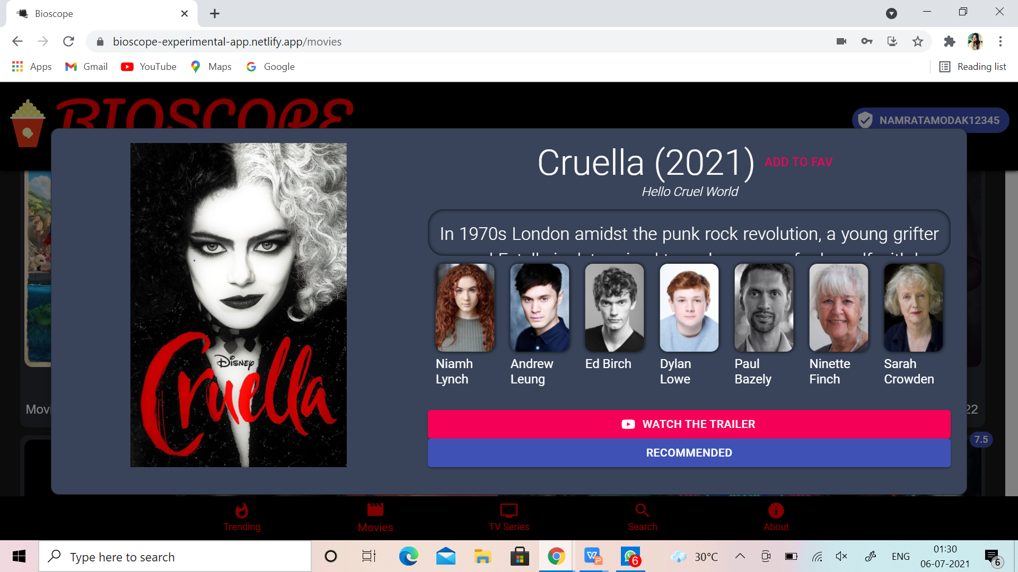
6)OFFICIAL TRAILERS:-
Any movie or TV show searched will
have an option of watching the
trailer.If clicked,it will lead us a to
a new tab in YouTube which will
play its official trailer.
Here,YouTube API is used.
Bioscope

Slide 31
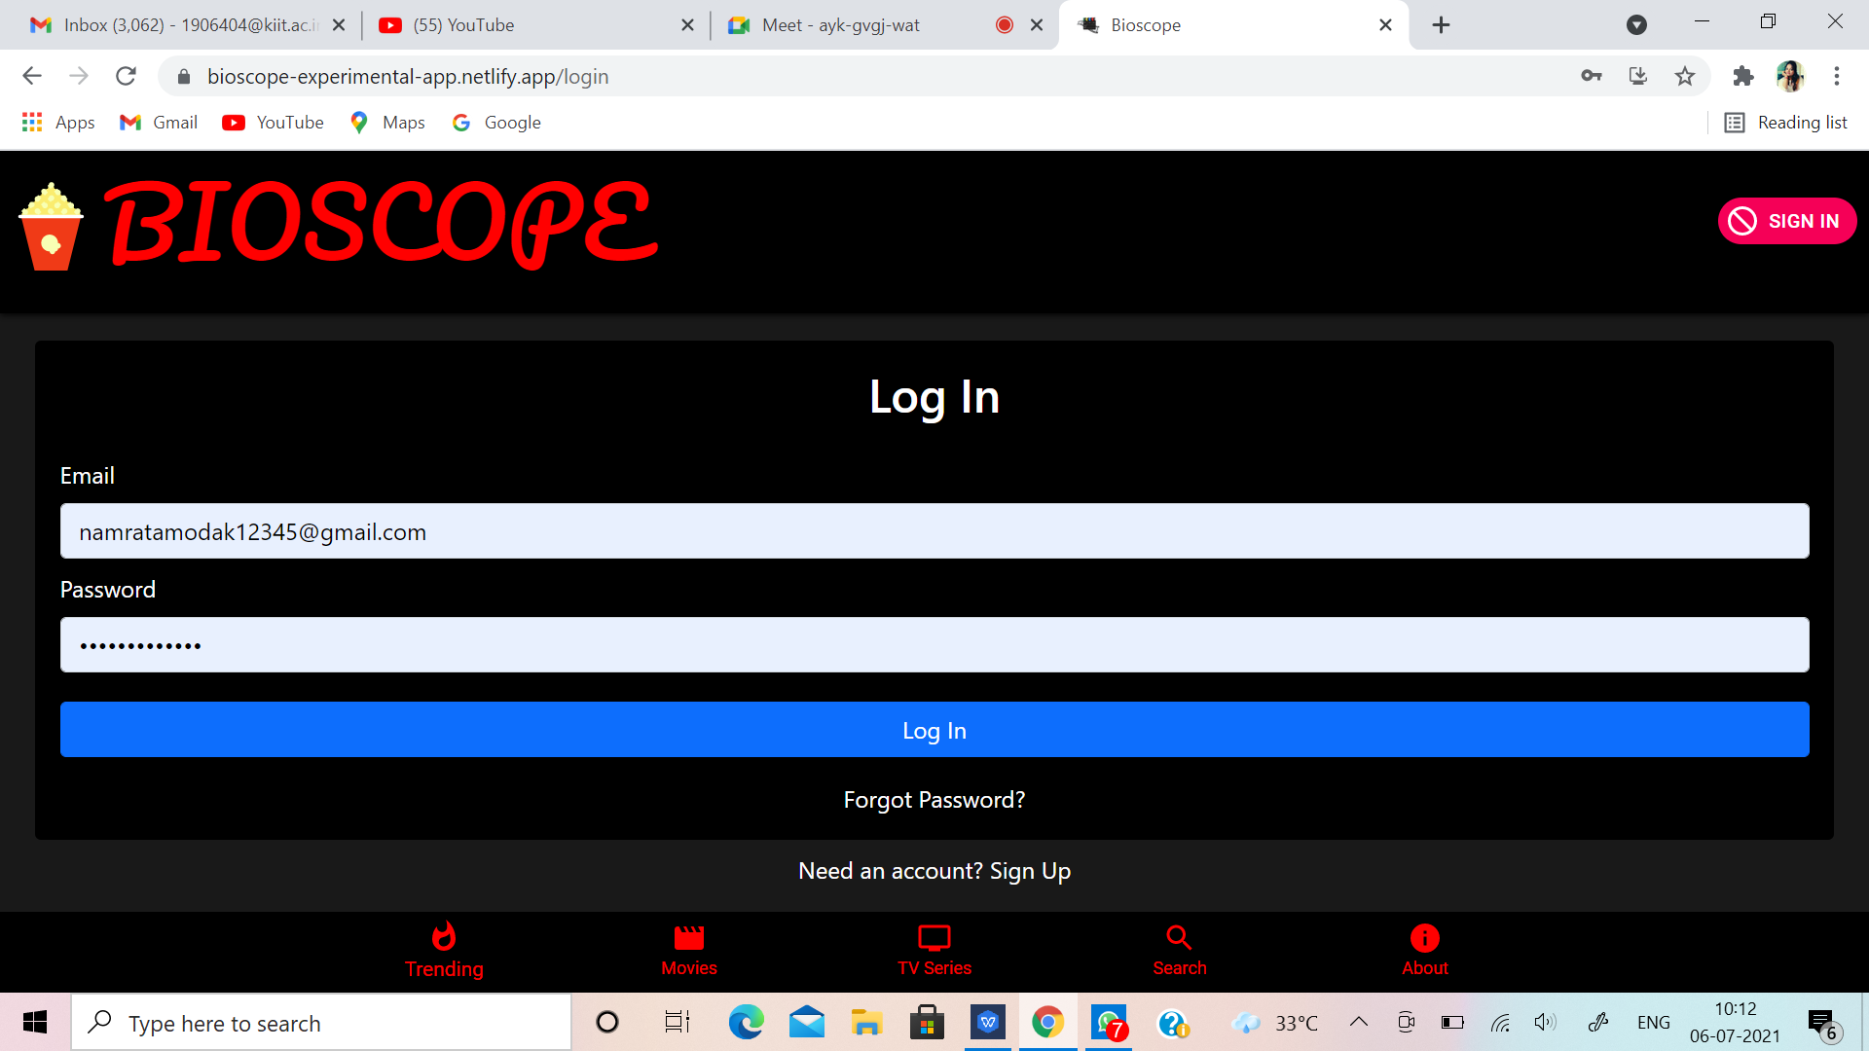
7)PASSWORD RECOVERY:-
If a user forgets the password,password
recovery is available.An option called
“Forgot Password?” is available there.On
clicking, it will ask for our mail where
the password recovery link will be sent.
After providing the registered mail a
password recovery link will be sent in the
registered mail from where we can
get access to the account. Here,
firebase and context API is used.
Bioscope

Slide 32
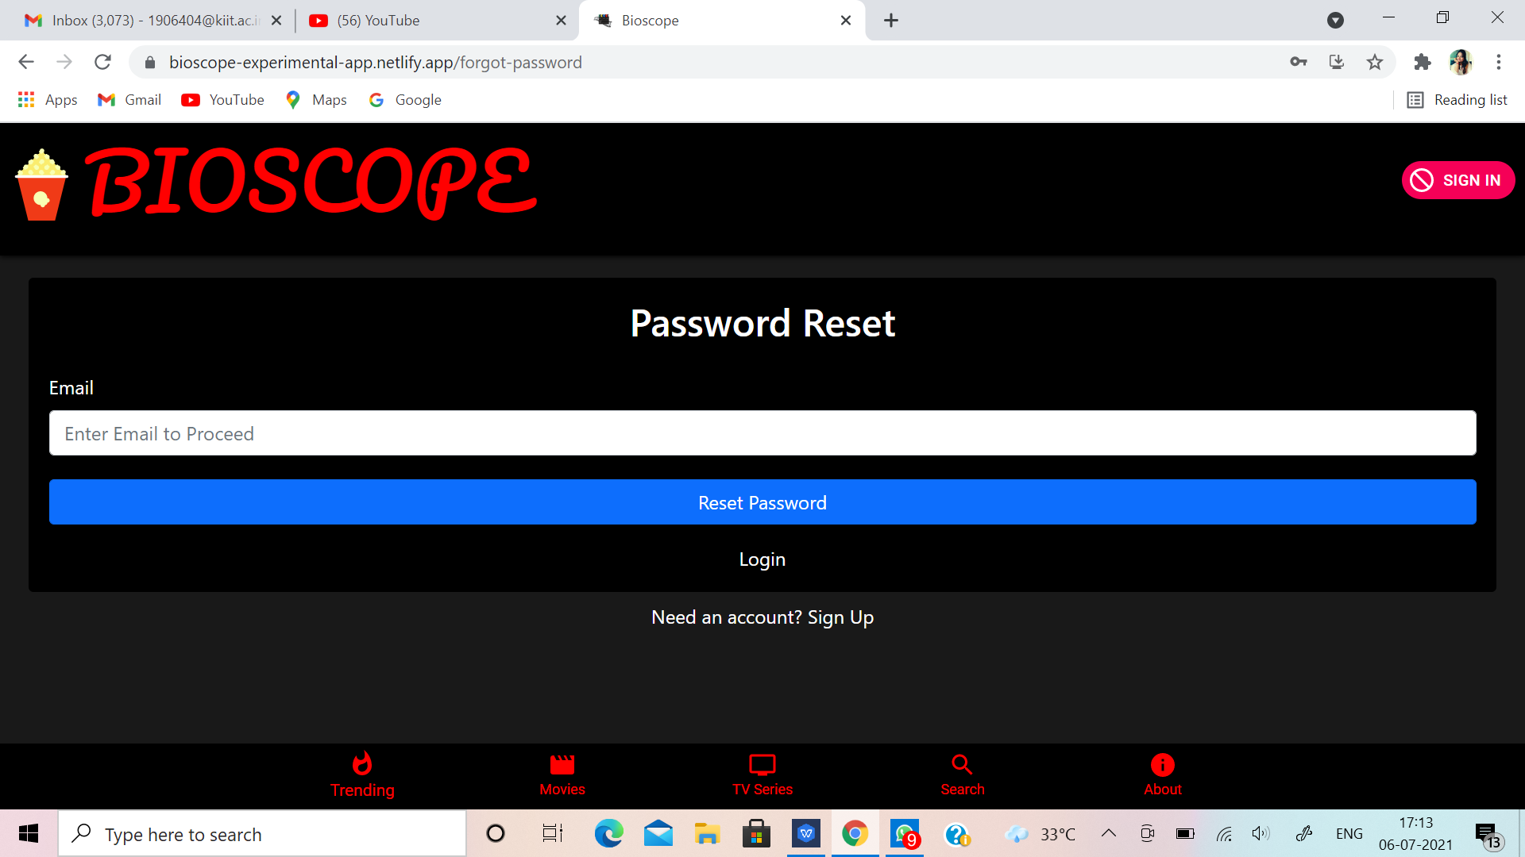
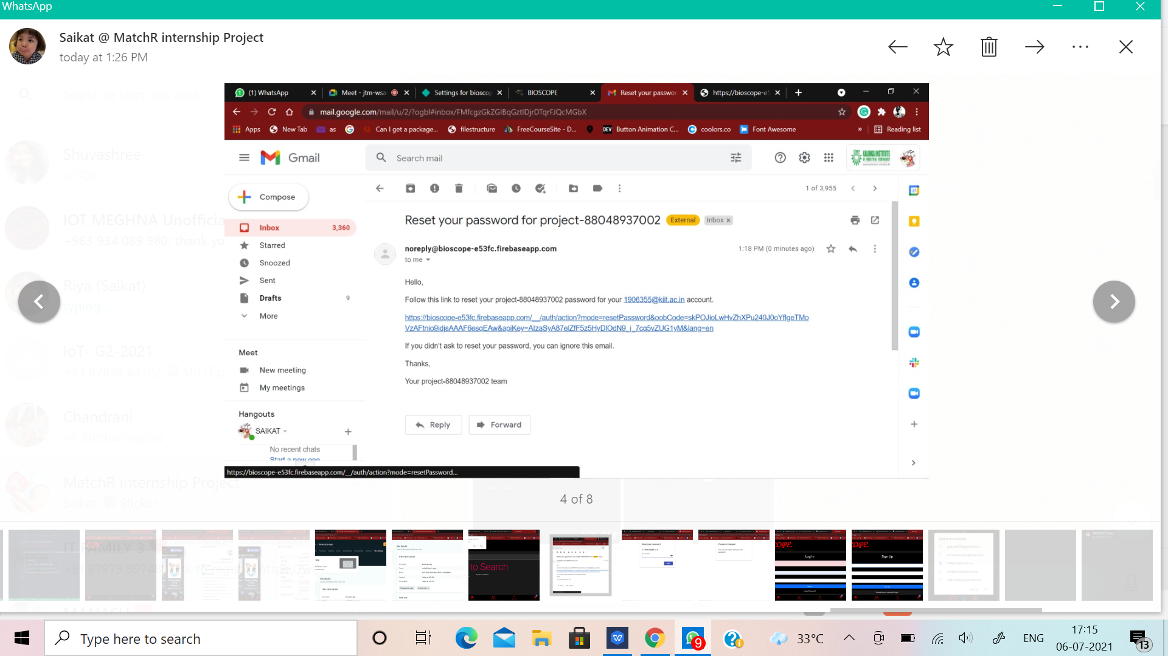
Enter the registered e-mail id in which the link will be sent.
Reset link for the password has been sent to the mail.
Bioscope

Slide 33
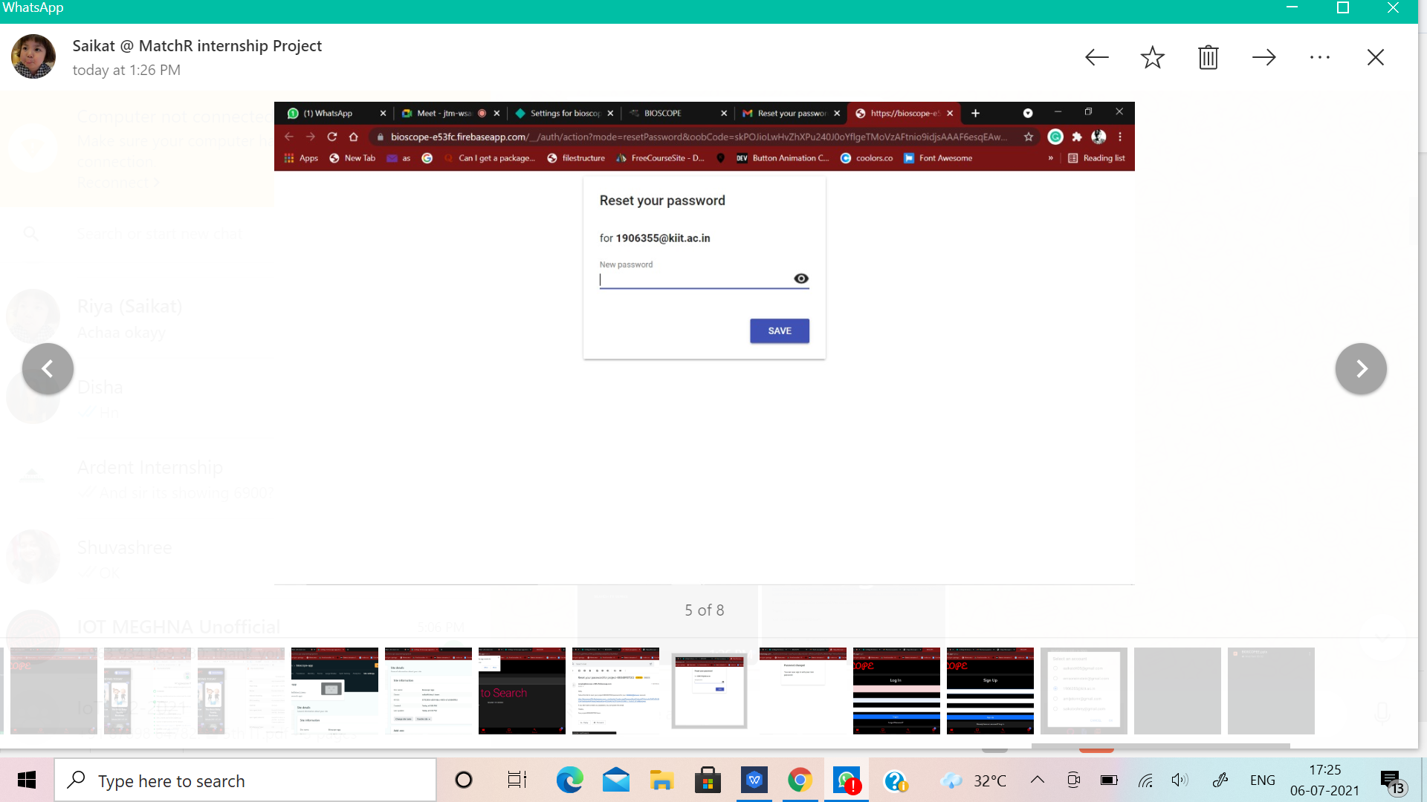
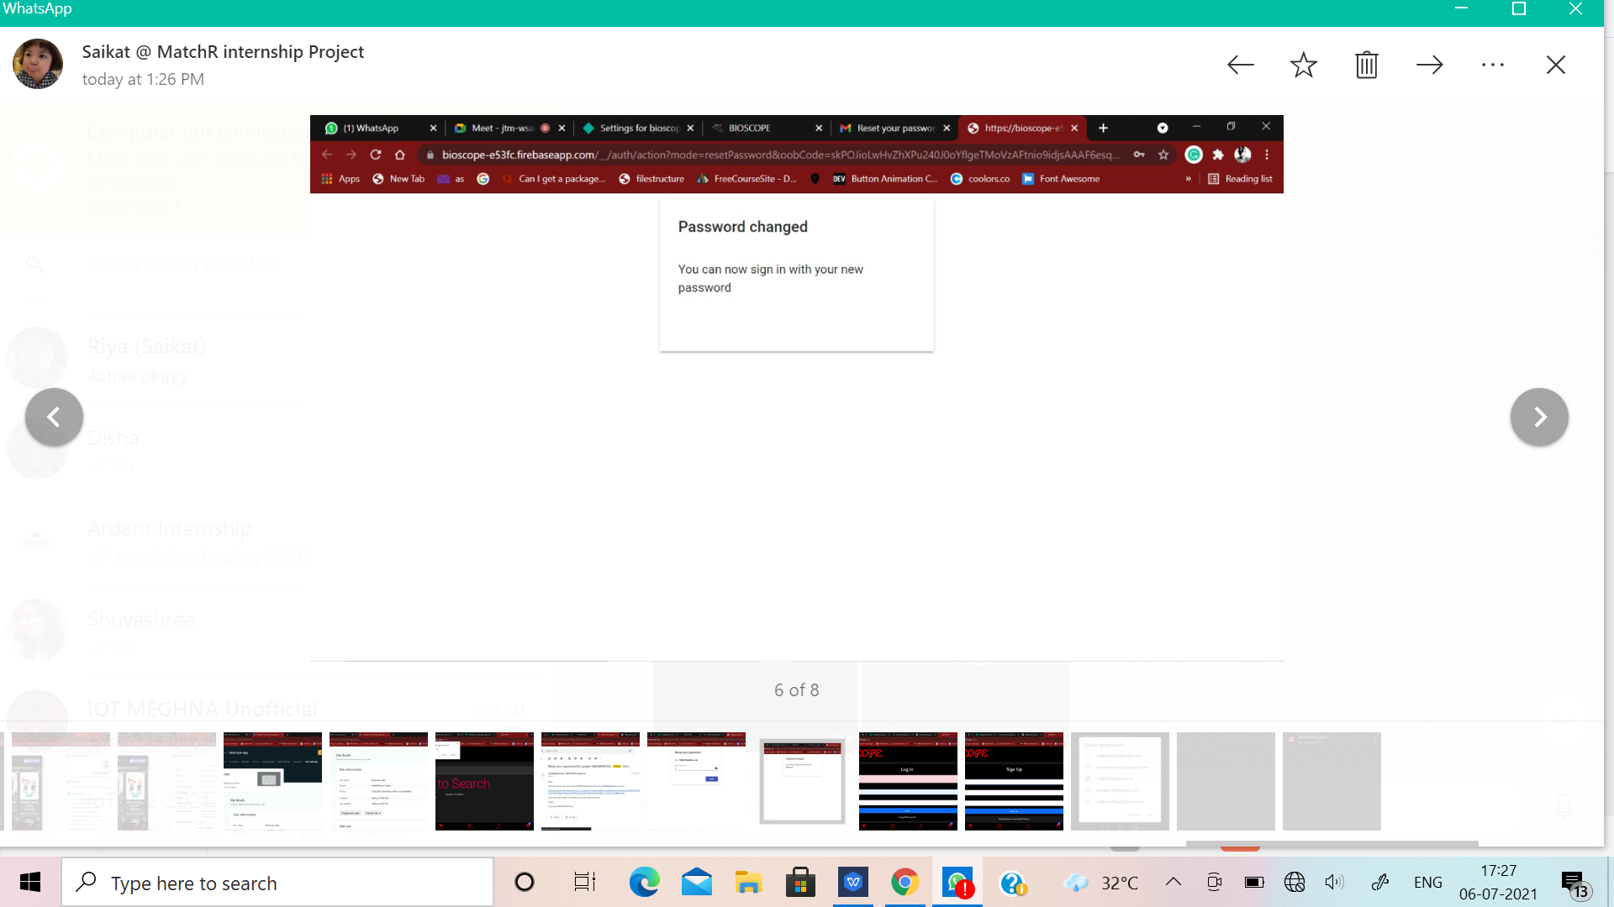
Type the new Password.
Password changed successfully.
Bioscope

Slide 34
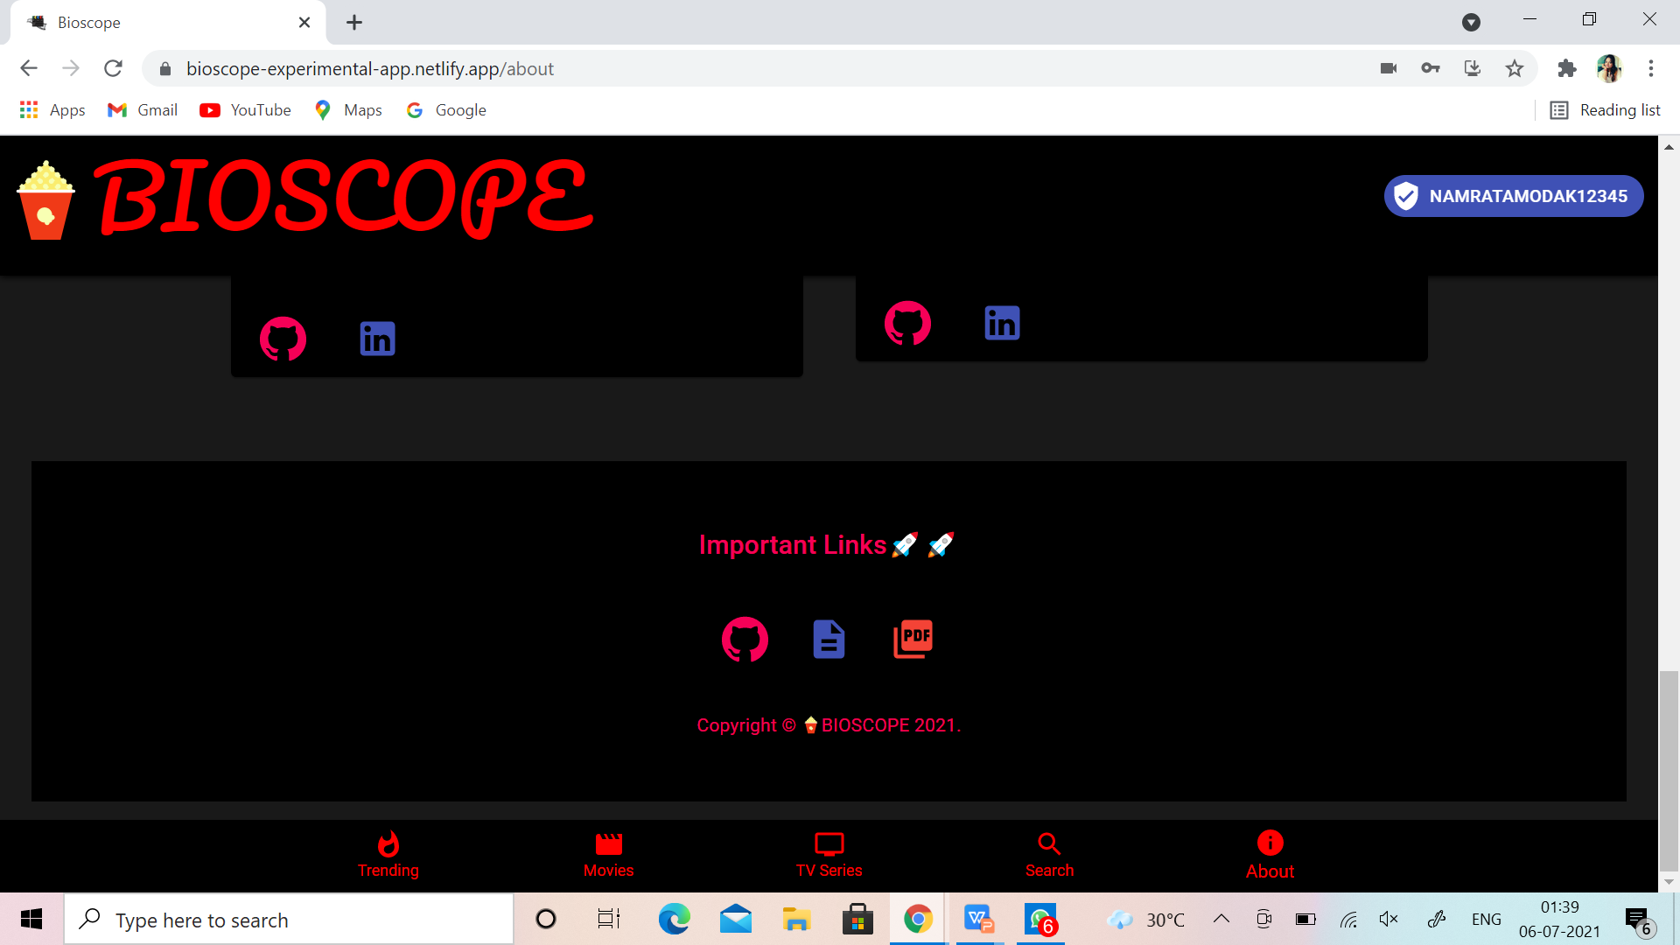
8)PDF DOWNLOAD:-
In the About section a option will be
available of downloading the pdf.
Here the presentation will get
downloaded in the pdf form and
henceforth one can easily look at
the idea-map of our app.
Bioscope

Slide 35

LANGUAGE-LIBRARY USED AND REASON FOR CHOOSING IT:-
Reusability
Fast learning curve
Fast render with virtual DOM
Great Developer Tools
Bioscope

Slide 36
CONCLUSION
This project is developed successfully . This project is designed to know the information related to the movies and tv series.It has been developed by using react and the database has been built in firestore keeping in mind the specifications of the system. The user will be able to know all the information about movies. We have designed the project to provide the user with easy retrieval of data, details of movies as much as possible. In this project, the user can install this app. The team bioscope has put all the hard work to give our app in to a realistic shape . We put all our efforts. We have gone through a lot of hard work and errors and Finally we came up with our brilliant a working app containg all our efforts in it. So we would definitely like you to give it a try.
THANKS from our team BIOSCOPE.
Bioscope

Slide 37

TV FEATURES:-fgjfjfjfjjf
THANK YOU !!!
Bioscope

